Slide 1

DEPARTMENT OF
ARTIFICIAL INTELLIGENCE AND DATA SCIENCE
ACADEMIC YEAR 2025 - 2026
SEMESTER III
ARTIFICIAL INTELLIGENCE LABORATORY
MINI PROJECT REVIEW
<PYSNAKE:AN CLASSIC GAME>
REGISTER NUMBER | 2117240070059
NAME | Dharshan MD
YEAR | 2nd
SECTION | A
FACULTY IN-CHARGE | Mrs. M. Divya

Slide 2
PROBLEM STATEMENT
Develop a feature-rich Snake game in Python using Pygame.
Include levels, power-ups, score tracking, and smooth gameplay.
Understand game mechanics, collision detection, and basic AI.
Enhance with power-ups, levels, and high score tracking.
Provide a user-friendly interface and smooth game flow.

Slide 3
THEORETICAL BACKGROUND
  Built using Pygame library for 2D graphics and input.
  Core logic based on Game Loop structure.
  Finite State Machine controls game states.
  Grid-based movement simplifies logic and collisions.
  Collision detection ensures interaction with food and walls.
  Possible AI algorithms: A*, BFS, or Reinforcement Learning

Slide 4
IMPLEMENTATION AND CODE
Link to code in Git-hub Repository
List | Git-hub Repository Links
Implementation of Code Link | https://github.com/Dharshan2007-art/AI-mini-project.git
Word Document Report Link
PPT Link

Slide 5
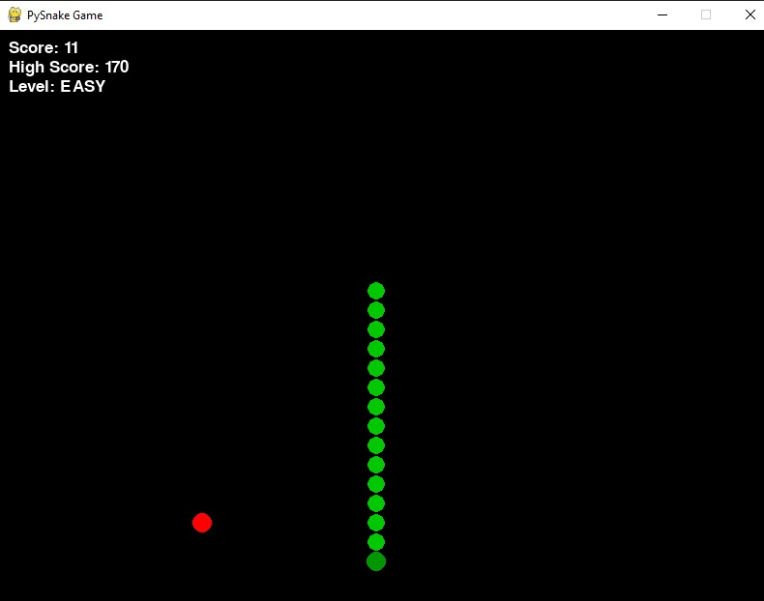
OUTPUT AND RESULTS

Slide 6
OUTPUT AND RESULTS
Start Screen: Title and “Start” button.
Level Select: Easy, Medium, Hard options.
Gameplay: Snake eats food, score increases.
Shield Active: Blue glow and timer display.
Pause Screen: Overlay with Continue option.
Game Over: Final score with Play Again / Quit options.

Slide 7
REFERENCES
Pygame Official Documentation – pygame.org/docs
Invent Your Own Computer Games with Python – Al Sweigart
Clear Code Pygame Tutorials – YouTube
Real Python – Pygame Articles and Guides
Game Programming Patterns – Robert Nystrom
Stack Overflow – Python & Pygame Developer Forum

